Slide 1
Where Do We Stand? A Regional Overview of Inequality
Lisa Kolovich, IMF
IMF Flickr

Slide 2
Setting the Scene
Focus of the course: discuss how distributional considerations can be essential in the formulation of macroeconomic policies.
Impacts:
Macroeconomic: Growth, productivity, and resilience
Distributional: Uneven across countries, sectors, workers, and households.
Policy Design:
Vulnerable groups often bear disproportionate share of adjustment costs.
Sound macroeconomic frameworks are essential—but policy effectiveness also depends on understanding who is affected, how, and through which channels.
Context:
Global economy is increasingly shock‑prone
Demographic changes
Digitalization
Rise of artificial intelligence

Slide 3
Distributional Channels and Macroeconomic Outcomes
Helpful Resources:
IMF Strategy Toward Mainstreaming Gender
Integrating Gender into Macroeconomic Policies at the IMF
GDP gains and Productivity
Greater financial stability
Economic diversification
Inequality
Legal rights, education, health, financial inclusion
LFP, wages,
representation/
leadership
Macro Outcomes
Economic growth and resilience,
macro-financial stability
Policies
fiscal, monetary, structural, financial

Slide 4
Helpful Definitions

Slide 5
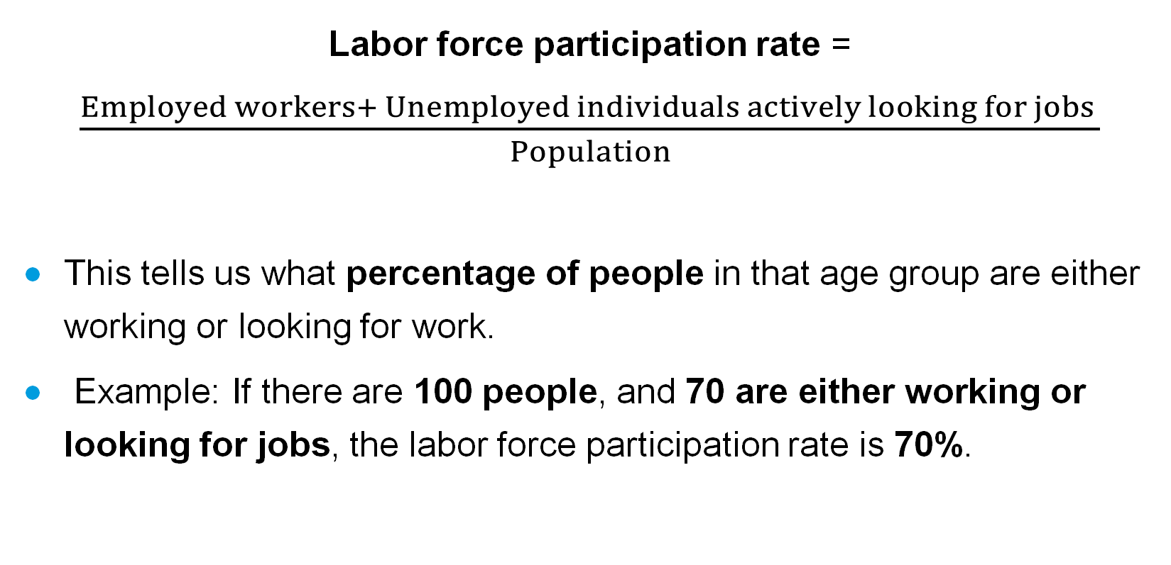
Labor force participation rate
Labor force participation rate = $\frac{Employed workers+ Unemployed individuals actively looking for jobs }{Population}$
This tells us what percentage of people in that age group are either working or looking for work.
Example: If there are 100 people, and 70 are either working or looking for jobs, the labor force participation rate is 70%.

Slide 6
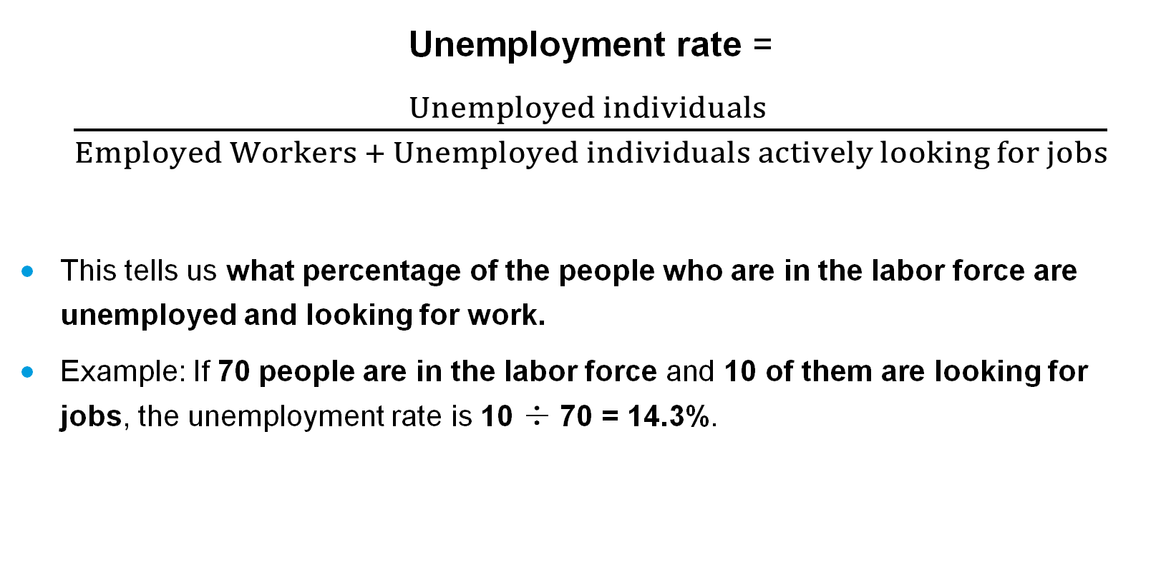
Unemployment rate
Unemployment rate = $\frac{Unemployed individuals }{Employed Workers + Unemployed individuals actively looking for jobs}$
This tells us what percentage of the people who are in the labor force are unemployed and looking for work.
Example: If 70 people are in the labor force and 10 of them are looking for jobs, the unemployment rate is 10 ÷ 70 = 14.3%.

Slide 7
Stylized Facts and Trends

Slide 8
Significant differences across regions, but trend towards lower inequality over last two decades.
Gender Inequality Index, 2000 – 2023
Source: Gender Inequality Index | Human Development Reports (Data visualization tool)
Note: The UNDP Gender Inequality Index considers labor force participation, education, women’s health outcomes (maternal death & adolescent fertility), and political representation. Higher numbers indicate higher levels of inequality.

Slide 9
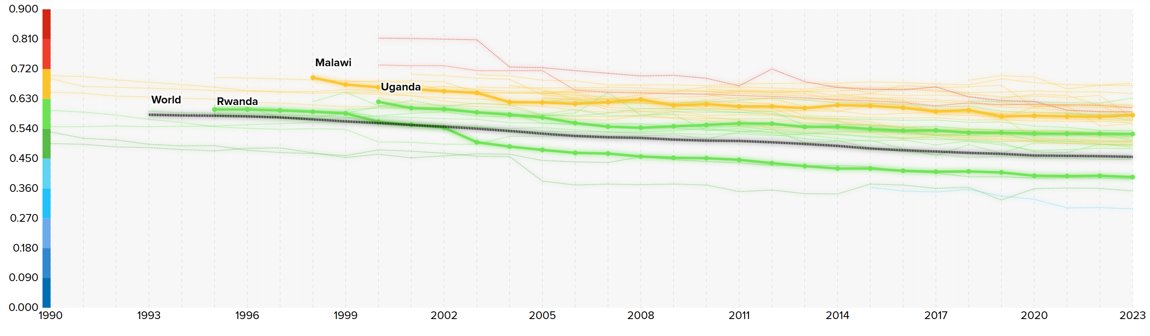
Country-level data: GII for Sub-Saharan Africa
Source: Gender Inequality Index | Human Development Reports (Data visualization tool)
Note: The UNDP Gender Inequality Index considers labor force participation, education, women’s health outcomes (maternal death & adolescent fertility), and political representation. Higher numbers indicate higher levels of inequality.

Slide 10
Stylized Facts and Trends Labor Markets

Slide 11
Labor markets are a key channel through which structural gaps affect employment, productivity, and inclusive growth.
Gaps in participation, employment, and job quality limit the effective supply of labor, weakening potential output.
Labor market frictions—especially for youth and women—reduce the economy’s ability to reallocate workers across sectors as shocks and structural changes occur.
Persistent labor market exclusion can lead to scarring, informality, and weaker attachment to the labor force, with long‑lasting macroeconomic effects.
From a macro perspective, segmented or underperforming labor markets weigh on growth, fiscal revenues, and economic resilience.

Slide 12
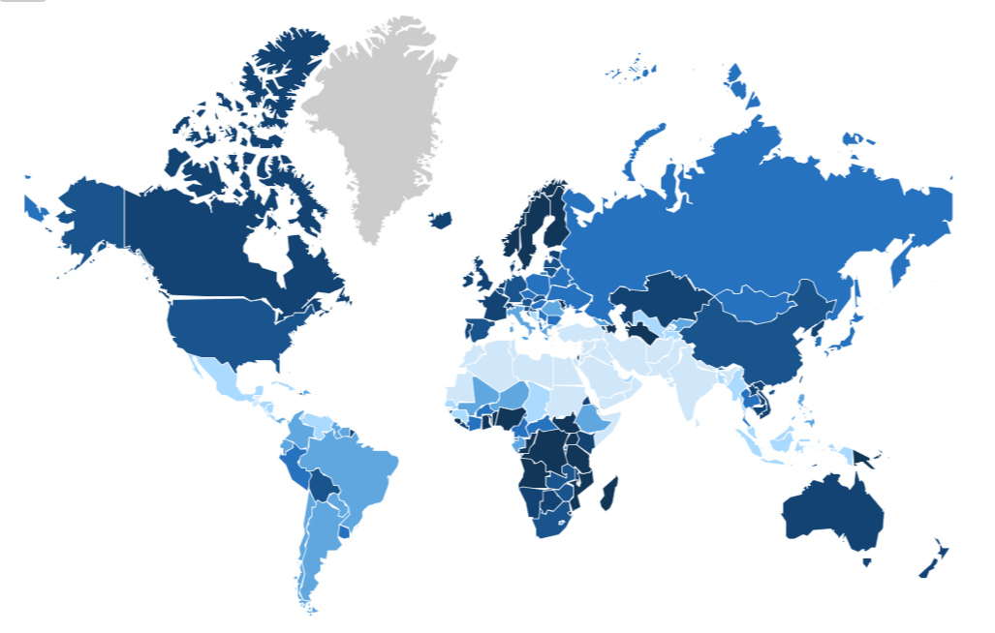
Structural gaps in labor force participation
Ratio of Female to Male Labor Force Participation (2024 or latest year)
FLFP has increased in many countries, but gaps remain.
What are possible drivers in your country?
What are the macroeconomic impacts?
Source: LFP rate (%)
World Bank Gender Data Portal
Note: For deeper dive, look at your country’s labor force surveys.

Slide 13
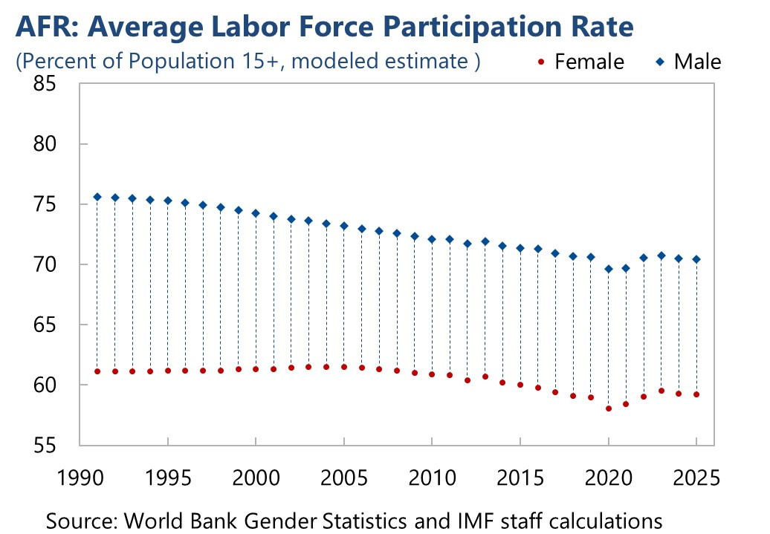
Evolution of Labor Force Participation
Note: AFR (IMF Africa Department)

Slide 14
Female Labor Force Participation Rate by Country
Botswana | 2025 | 64%
Eswatini | 2025 | 49%
Ethiopia | 2025 | 59%
Gambia, The | 2025 | 46%
Ghana | 2025 | 55%
Kenya | 2025 | 63%
Lesotho | 2025 | 48%
Liberia | 2025 | 72%
Malawi | 2025 | 58%
Mauritius | 2025 | 48%
Namibia | 2025 | 55%
Nigeria | 2025 | 81%
Rwanda | 2025 | 57%
Seychelles | 2025 | N/A
Sierra Leone | 2025 | 52%
South Sudan | 2023 | 70%
Uganda | 2025 | 76%
Zambia | 2025 | 56%
Notes: Ages 15+, Modeled ILO Estimate 1990 – 2025
Source: WDI Indicators

Slide 15
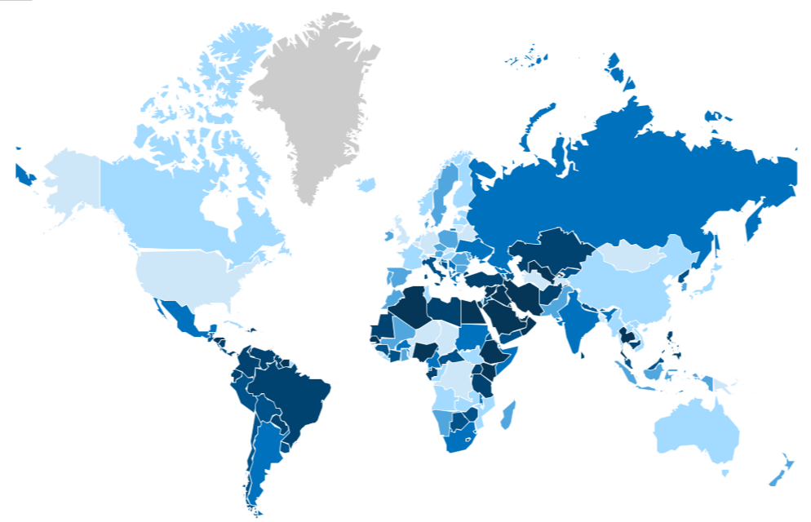
Inequalities can limit labor market entry, skill utilization, and adjustment.
Ratio of Female to Male Unemployment Rates, Ages 15-24 (2024 or latest year)
Rates are high in many countries, but there are systematic differences across population groups.
Persistent youth unemployment can lead to human capital scarring, lower lifetime earnings, and weaker productivity growth.
Higher female youth unemployment may reflect structural constraints.
Question: What are key constraints in your country?
95-106%
Source: Unemployment rate (% ages 15-24) | World Bank Gender Data Portal

Slide 16
Stylized Facts and Trends Human Capital Development

Slide 17
Human capital is a core driver of long‑run growth, productivity, and income convergence.
Gaps in education and literacy reduce the effective supply of skilled labor, constraining sectoral upgrading and diversification.
Lower human capital slows technology adoption, weakens complementarities with capital investment, and limits productivity gains from digitalization and AI.
Uneven skill formation can amplify the distributional impact of shocks and reforms, slowing adjustment and recovery.
From a macro perspective, persistent human capital gaps weigh on potential growth, fiscal revenues, and economic resilience.

Slide 18
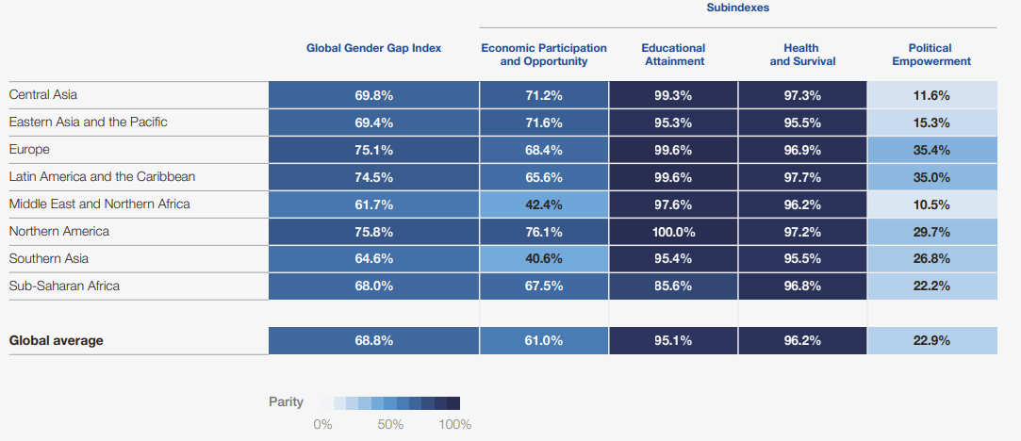
Education gaps constrain human capital and productivity
Source: Benchmarking gender gaps, 2025 - Global Gender Gap Report 2025 | World Economic Forum
Note: Population-weighted averages for 148 economies.
Notes:
Source: World Economic Forum (2023).
Terms of Use: https://www.weforum.org/about/licence-terms-on-the-use-of-forum-publications-and-materials-licence-terms.
Gaps in economic participation persist; low gender gaps in education & health. SSA has the highest gaps in education attainment, but economic participation and opportunity is similar to that in Western Europe. However, these statistics do not capture the quality of jobs.

Slide 19
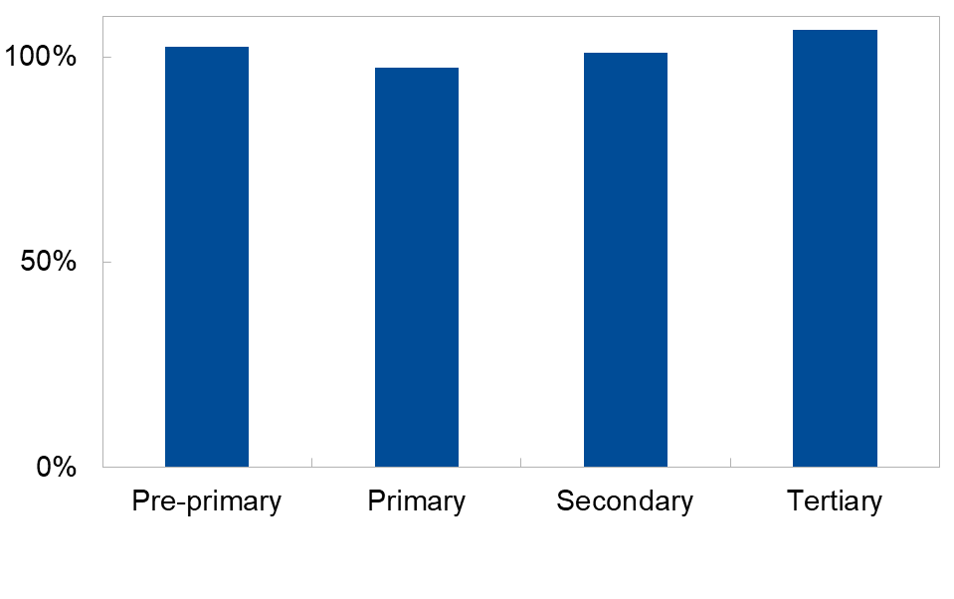
On average, school enrollment rates are near parity in the region.
Female to Male School Enrollment Ratio, 2024 or latest year available, (percent)
Let’s Discuss:
Consider LFP, unemployment, and job quality. Does parity in enrollment rates translate into similar skills or labor market outcomes?
Source: World Bank Gender Statistics

Slide 20
While rates may be near parity, the levels of secondary and tertiary education are much lower than primary rates.
 | Pre-primary |  |  | Primary |  |  | Secondary |  |  | Tertiary
 | Male | Female | Ratio | Male | Female | Ratio | Male | Female | Ratio | Male | Female | Ratio
AFR | 36.4 | 37.3 | 1.03 | 102.3 | 99.7 | 0.97 | 58.0 | 58.7 | 1.01 | 11.3 | 12.0 | 1.07
Let’s Discuss:
Regional averages may also mask substantial cross‑country differences in education gaps. What should we do to address this?
What other variables may be helpful when we are looking at human capital development and macroeconomic outcomes?
Why should we consider country‑specific analysis when aiming to design policies on human capital?
Source: World Bank Gender Data Portal

Slide 21
Stylized Facts and Trends Not in Employment, Education, or Training (NEET)

Slide 22
Disruptions in school‑to‑work transitions have macrocritical consequences
Smooth transitions from education to employment are critical for human capital utilization, productivity, and long‑run growth.
When young people struggle to enter work or training, skills depreciate, attachment to the labor force weakens, and scarring risks rise.
Weak school‑to‑work transitions reduce the economy’s ability to reallocate labor as structural change and shocks occur.
From a macro perspective, persistent youth disengagement weighs on potential output, fiscal revenues, and economic resilience.
NEET rates provide a summary indicator of these transition failures and their macroeconomic cost.

Slide 23
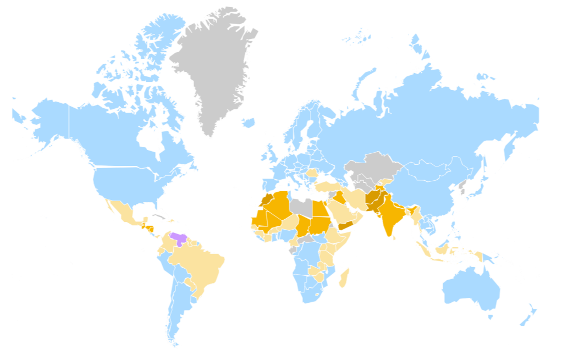
High NEET rates signal structural barriers to labor market entry.
Gap Between Male and Female Rates of NEET (ages 15-24), 2024 or latest year available
Elevated NEET rates imply underutilized labor and lost human capital, with adverse effects on productivity and long‑term growth.
Higher NEET rates among young women often reflect structural constraints.
Persistent disengagement during early working years can lead to scarring, weaker attachment to the labor market, and slower post‑shock recovery.
Source: World Bank Gender Data Portal

Slide 24
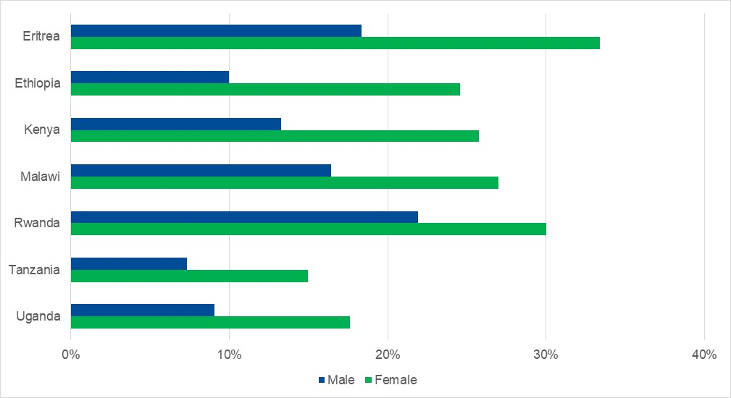
NEET gaps point to the need for more granular diagnostics and tailored macro policies
NEET Rate, Ages 15-24, 2024 or latest year available, by sex (%)
NEET rates aggregate multiple constraints—education, labor markets, care responsibilities, informality, and demand conditions—into a single indicator of disengagement.
Large gender gaps highlight where macro policies may not be reaching all segments of the population equally.
Designing effective policy responses requires going beyond averages to identify which groups are disengaged and why.
Source: World Bank Gender Data Portal

Slide 25
Stylized Facts and Trends Financial Inclusion

Slide 26
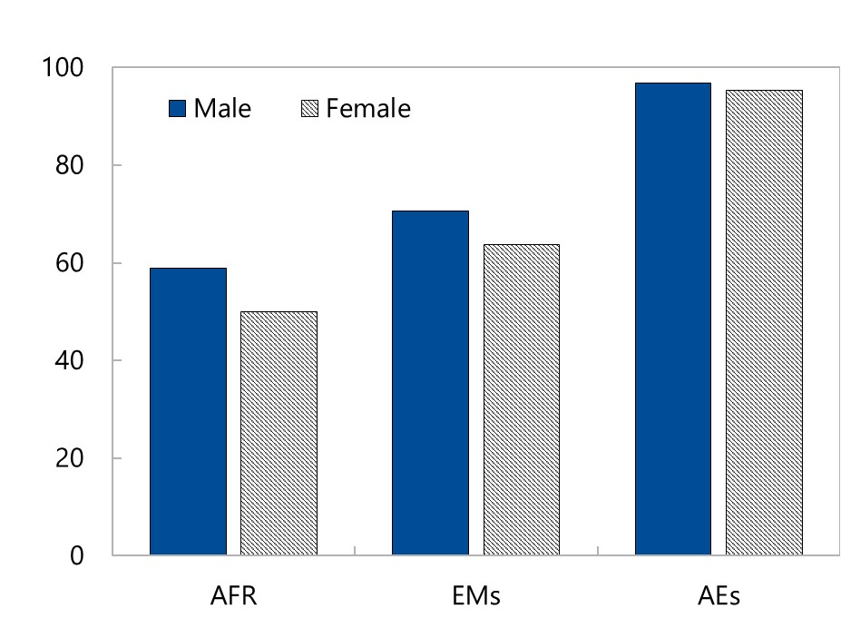
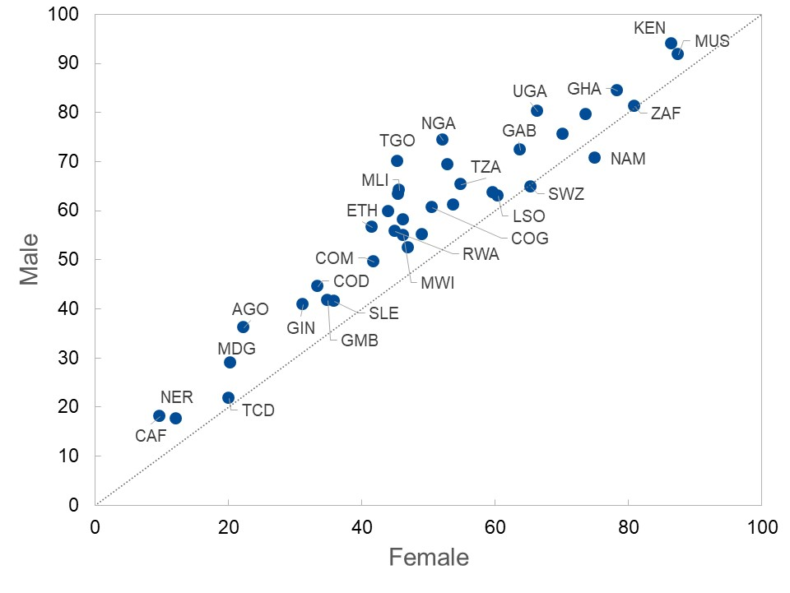
The female rate of account ownership is about 9 percentage points lower than the male rate in SSA.
Account Ownership by Gender, 2024 or Latest Year (percent)
Source: World Bank Gender Data Portal
Note: AFR (IMF Africa Department); EMs (Emerging Markets); AEs (Advanced Economies)

Slide 27
Stylized Facts and Trends Legal Barriers

Slide 28
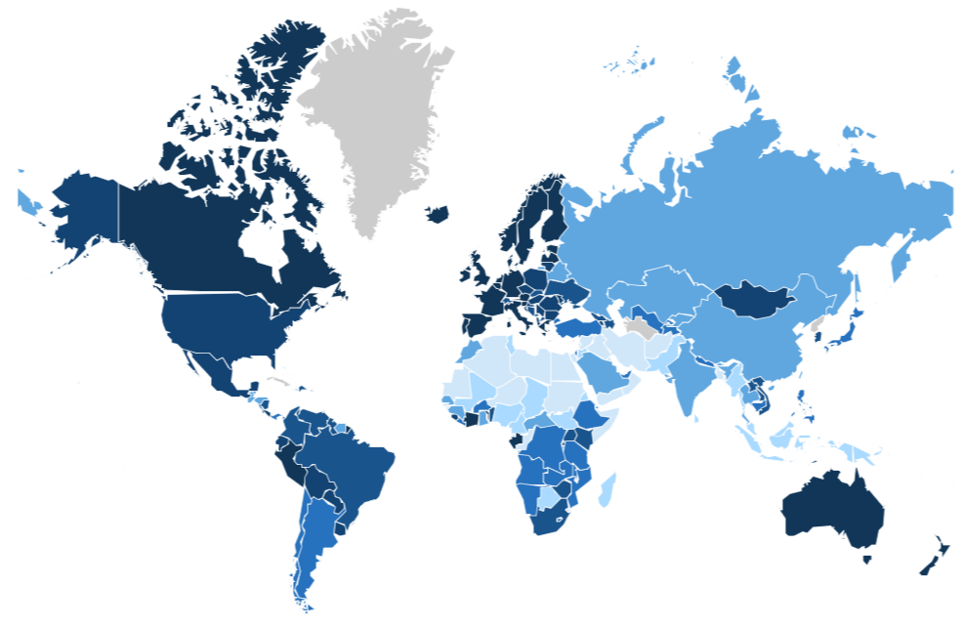
Countries have made much progress on legal reforms, but barriers remain.
Women, Business and the Law Index, 2023
Source: Women Business and the Law Index Score (scale 1-100) | World Bank Gender Data Portal
Notes:
Legal restrictions on women have become less significant over time. However, even today, there are few countries where legal rights for men and women are completely equal. This figure shows an overall index of legal equality, which captures important dimensions including:
The right to own property.
The right to inherit property.
The right to open financial accounts.
Effective laws against sexual harassment.
In general, legal inequality is particularly high in the Middle East, and to a lesser degree in Africa.
In many developing countries, divorce or widowhood can cause women to become landless and lose their assets. Again, we discuss these issues in greater depth later in the course.
Workshop activity (later!): look into the World Bank database on legal restrictions, focusing on your own country.

Slide 29
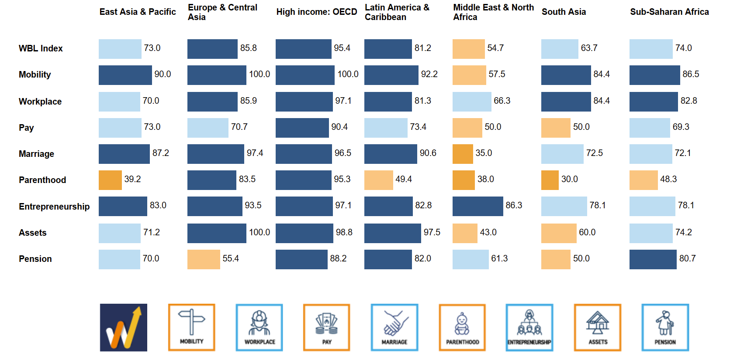
Key areas for potential legal reforms include “Marriage,” “Parenthood,” and “Assets” laws.
Let’s Discuss:
What legal restrictions on women exist in your country? Use Women, Business and the Law Data
How do they limit opportunities?
Source: Women, Business, and the Law: Data Visualization

Slide 30
Questions for Discussion In your country, which gaps in economic opportunities and outcomes could have macroeconomic impacts? Through which channels (labor supply, human capital, productivity, access to finance) do these gaps affect growth, stability, and resilience? What evidence (e.g. from national statistics, your own analysis, today’s presentation) supports that conclusion?

